Slide 1


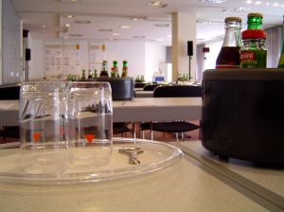
MANAGE SPECIAL EVENTS
D1.HML.CL10.08 D1.HRM.CL9.07
Notes:
Trainer welcomes trainees to class and introduces himself/herself.

Slide 2

Subject Elements
This unit comprises eight Elements:
Develop event concept and proposal
Determine event venue/location
Plan and deliver event catering
Plan and deliver sponsorship plans
Notes:
Trainer advises this Unit comprises eight Elements, as listed on the slide explaining:
• Each Element comprises a number of Performance Criteria which will be identified throughout the class and explained in detail
• Trainees can obtain more detail from their Trainee Manual
• At times the course presents advice and information about various protocols but where their workplace requirements differ to what is presented, the workplace practices and standards, as well as policies and procedures must be observed.

Slide 3
Subject Elements
This unit comprises eight Elements:
Plan and deliver event management
Plan and deliver event registration
Plan and deliver infrastructure for outdoor event
Conduct post-event evaluation
Notes:
Trainer advises this Unit comprises eight Elements, as listed on the slide explaining:
• Each Element comprises a number of Performance Criteria which will be identified throughout the class and explained in detail
• Trainees can obtain more detail from their Trainee Manual
• At times the course presents advice and information about various protocols but where their workplace requirements differ to what is presented, the workplace practices and standards, as well as policies and procedures must be observed.

Slide 4

Assessment
Assessment for this unit may include:
Oral questions
Written questions
Work projects
Workplace observation of practical skills
Practical exercises
Formal report from supervisor
Notes:
Trainer advises that assessment for this Unit may take several forms all of which are aimed at verifying they have achieved competency for the Unit as required.
Trainer indicates the methods of assessment that will be applied to them for this Unit.

Slide 5
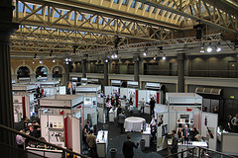
Element 1:
Develop event concept and proposal
Notes:
Introduce topic.
Class Activity – General Discussion
Ask general questions:
What is an event?
What are different event concepts?
What is a proposal?
What is normally included in an event proposal?

Slide 6
Develop event concept and proposal
Performance Criteria for this Element are:
Identify event objectives and scope
Establish event concept, theme, format and protocols
Prepare event brief
Develop event proposal/bid details, where necessary
Notes:
Trainer identifies the Performance Criteria for this Element, as listed on the slide.

Slide 7
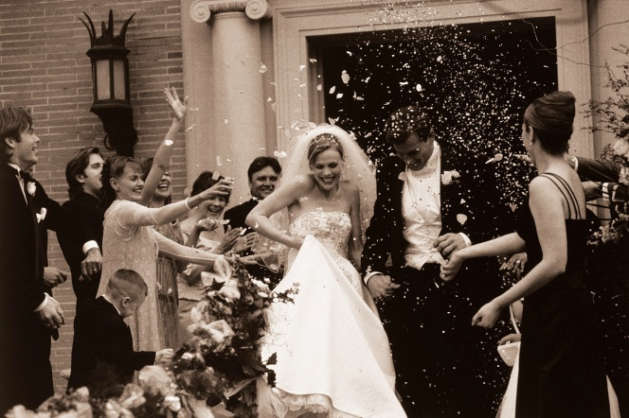
Events
What is an event?
What events have you been to in the past?
Notes:
Class Activity – General Discussion
Get audience to discuss the events that they have attended in the past.

Slide 8
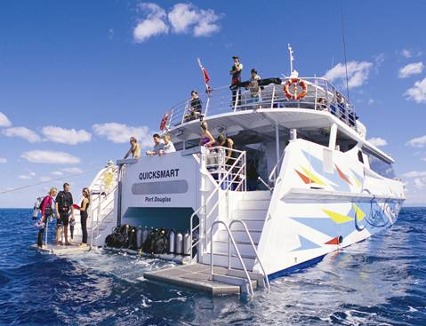
Events
Types of event venues
Homes for private functions
Meetings, banquets, conventions, and weddings
Nature areas including open water, zoos, parks, wineries
Transportation vehicles – including planes, yachts, cars, buses
Notes:
Class Activity – General Discussion
What needs to be arranged for these types of events?
Where are they normally held?

Slide 9

Events
Types of events
Festivals
Sporting events
Birthday parties
Anniversaries
Notes:
Class Activity – General Discussion
What needs to be arranged for these types of events?
Where are they normally held?

Slide 10

Benefits of events
What are the benefits:
For the customer
For the organisation
Notes:
Class Activity – General Discussion & Questions
Get audience to discuss the benefits for both parties.

Slide 11
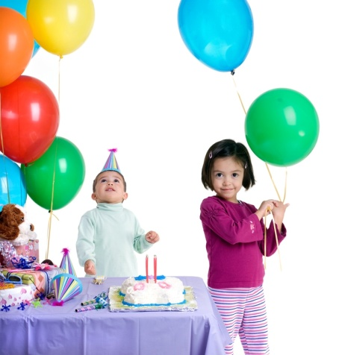
Types of events
Breakfasts
Lunches
Dinners
Seminars, workshops and conferences
Cocktail parties
General parties, birthdays and celebrations
Wedding receptions
Notes:
Class Activity – General Questions
What types of food and beverage are served at these?
What facilities mentioned before would be appropriate to hold these events?

Slide 12

Types of events
Anniversaries
21st birthday parties
Product launches and distributor functions
School formals, annual dinners and dinner dances
Annual general meetings
Training seminars
Graduations and award nights
Notes:
Class Activity – General Questions
What types of food and beverage are served at these?
What facilities mentioned before would be appropriate to hold these events?

Slide 13

Types of events
Press receptions
Fashion shows
Special events
Tradeshows
Stage productions, including music events
Notes:
Class Activity – General Questions
What types of food and beverage are served at these?
What facilities mentioned before would be appropriate to hold these events?

Slide 14

Types of events
MICE
Many venues focus on the MICE sector of the industry.
MICE stands for:
Meetings
Incentives
Conferences
Events
Notes:
Class Activity – General Questions
What types of events are associated with each category?
Why is the MICE sector very appealing to hotels as a key market to attract?

Slide 15

Types of events
MICE
Meetings include general business meetings
Incentives refers to functions that businesses organise to reward or motivate staff
Conferences are usually business/industry based occasions where people get together to discuss issues and share knowledge
Events can include bands, concerts, entertainments
Notes:
Class Activity – General Discussion
Discuss these points.

Slide 16

Event facilities
In most hotels there is a dedicated area for events, which can cater to a wide variety of activities comprising each event.
What areas / facilities can be used for events within a hotel?
Notes:
Class Activity – General Questions & List function facilities
Answer question in slide
Get audience to list all the facilities / spaces that can be used for an event.

Slide 17
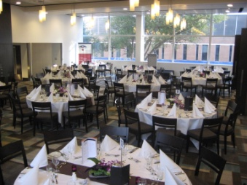
Event facilities
Range of facilities
Meeting/conference room
Stand up conference areas
Banquet room
Exhibition bays and space
Business centres
Notes:
Class Activity – General Questions
What is each facility used for?

Slide 18
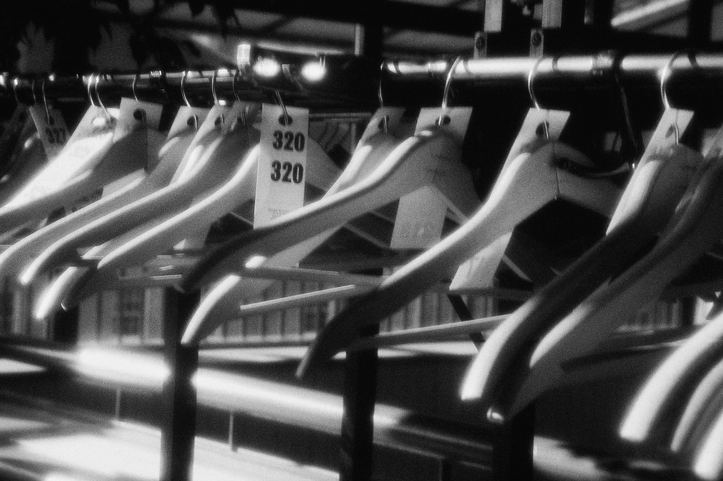
Event facilities
Range of facilities
Auditoriums
Press rooms
Storage bays
Parking facilities
Change rooms
Notes:
Class Activity – General Questions
What needs to be included in a facility for the press?
What different types of storage areas are needed and for what purpose?

Slide 19
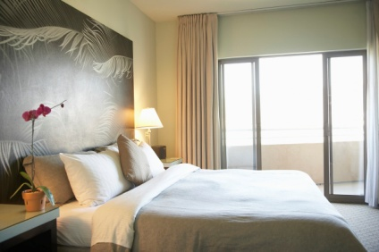
Event facilities
Range of facilities
Display areas
Designated and discreet sections of restaurants and/or bars
Food and beverage service
Accommodation
Notes:
Class Activity – General Questions
What are restaurant and bar areas used for?
What food and beverage services are provided?
What are accommodation rooms used for?

Slide 20
Event facilities
Range of facilities
Sound and lighting
Communication technologies and equipment
Music facilities
Gardens
Notes:
Class Activity – General Questions
What types of sound and lighting is available? What are they used for?
What technology is used in functions?
What equipment is used in functions?
What are gardens normally used for?

Slide 21

Receiving an enquiry
Information to collect
Contact person
Contact details
Type of event
Location
Date and time of event
Notes:
Class Activity – General Questions
How do people normally make an enquiry for an event?
What information do they need?

Slide 22
Receiving an enquiry
Information to collect
Budget
Possible number of attendees or guests
Overview of event requirements
Special instructions or requests
Notes:
Class Activity – General Questions
How do people normally make an enquiry for an event?
What information do they need?

Slide 23

Meeting with clients
After receiving an enquiry and once initial information has been sent to clients regarding an event or function it is best practice to invite the client to your venue to:
Talk to them about their expectations and needs
Allow them to view the property and its facilities
Meet some of the key staff, where appropriate
Notes:
Class Activity – General Questions
Why is meeting with clients?
What do you want to achieve when meeting with clients?

Slide 24
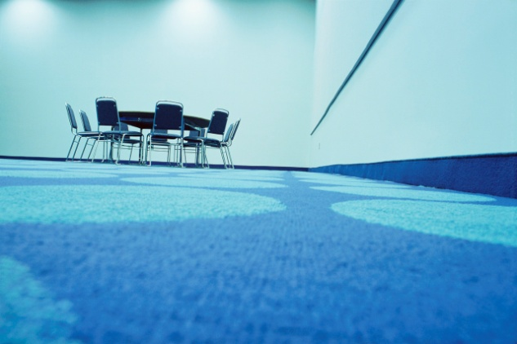
Determine customer needs
Types of customer needs
A specific day and date
Style and format of function
Location
Timing and duration considerations
Food and beverage
Accommodation
Notes:
Class Activity – Discussion
Discuss points.

Slide 25

Event considerations
Entertainment
Specialist technology services
Equipment
Ancillary services and rooms
Guest numbers
Privacy
Budget
Notes:
Class Activity – Discussion
Discuss points.

Slide 26

Event considerations
Access
Security
Themes and decorations
Role of media
External providers
Notes:
Class Activity – Discussion
Discuss points.

Slide 27
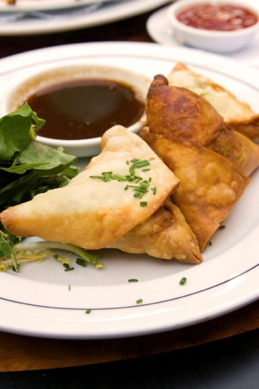
Function set up options
Stand-up function
This style of function is generally used for:
Cocktail parties
General parties
Lunches that are part of a conference
Notes:
Class Activity – General Questions
Discuss this set up option
What equipment items are required?

Slide 28
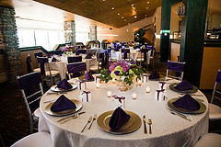
Event set up options
Sit down function
This style of function is generally used for:
Weddings
Formal dinners
Banquets
Presentations
Dinners for conferences
Notes:
Class Activity – General Questions
In what types of functions is this style of service popular?

Slide 29
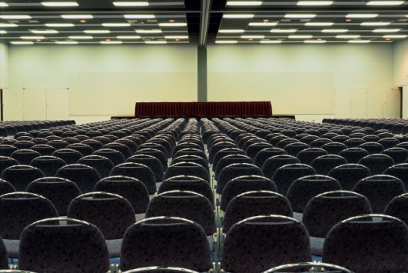
Event set up options
Meetings
Theatre style
Boardroom style
Hollow square
Classroom style
Banquet style
U Shape
E-shape
Notes:
Class Activity – General Questions
What are each of this set up options used for?
What are the benefits of each option?

Slide 30
Key stakeholders
Identification of key stakeholders
Event principal
Local community
Organising committees
Local authorities including police and fire
Internal event staff
External contractors
Entertainers
Talent
Staff from host businesses
Notes:
Class Activity – General Questions
What is the role of these stakeholders?

Slide 31

Liaison and management structure
Event liaison and management structure
It is vital to confirm:
Event liaison
Management structure
Lines of authority
Notes:
Class Activity – Discuss the importance of these points
Event liaison – who are the contact people communications be directed to and who needs to be copied or involved in communication
Management structure – who are key managers in relation to different aspects of an event
Lines of authority - who are the ultimate decision makers or have overriding authority and responsibility.

Slide 32

Identify options for events
Some clients have extensive experience with planning an event and many do not. Some clients will expect you to assist them in developing and planning their event, and others will not.
How do you identify if the client needs planning assistance?
Who can provide advice and suggestions?
Notes:
Class Activity – Discuss the questions in the slide

Slide 33

Prepare event brief
Once the event organiser has had an initial meeting with the client, they will now be able to prepare an event brief, in which to base their proposal and quotation of prices
An event brief is the template which contains all necessary information relating to a catered event of function
Notes:
Class Activity – Discussion
What is included inside an event brief?

Slide 34
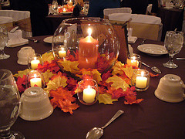
Contents of an event brief
Agreed event details
Identification of stakeholders
Allocation of responsibilities and setting of milestones and task completion dates
Type of function
Name, address, and contact number of client
Day, date and time of the function
Rooms and locations
Costings
Notes:
Class Activity – Discussion
Discuss these points.

Slide 35
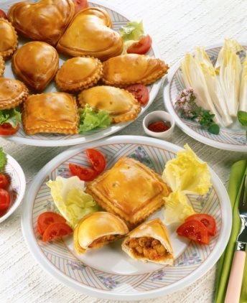
Contents of an event brief
Billing instructions
Menu
Beverage arrangements
Sequence of service
Entertainment
Room set up
Type of service
Special requirements
Notes:
Class Activity – Discussion
Discuss these points.

Slide 36

Provide proposal to client
All potential clients will need to be supplied with a proposal for their function before they commit to booking it and paying a deposit.
What should be included in a proposal?
Notes:
Class Activity – Questions
Discuss question in the slide and list items.

Slide 37

Element 2:
Determine event venue/location
Notes:
Introduce topic.
Class Activity – General Discussion
Ask general questions:
What is are common event venues and locations?
Why are they used?

Slide 38
Determine event venue/location
Performance Criteria for this Element are:
Identify potential event venues and sites
Analyse alternative event venues and sites
Select event venue/site
Confirm arrangements for selected venue/site
Notes:
Trainer identifies the Performance Criteria for this Element, as listed on the slide.

Slide 39

Identify potential venues and sites
Venue / location considerations
Location in relation to office, public transport or potential audience
Indoor / outdoor location
Venue quality or brand
Space
Reputation
Aesthetic appeal
Accommodation
Venue facilities and services
Cost
Notes:
Class Activity – Discussion
Discuss considerations associated with each point.

Slide 40
Identify potential venues and sites
Potential event locations
Hotels
Resorts
Restaurants
Homes for private functions
Schools, universities and other educational providers
Meetings rooms
Banquet rooms
Notes:
Class Activity – Discussion
What types of functions would be held in these locations?

Slide 41
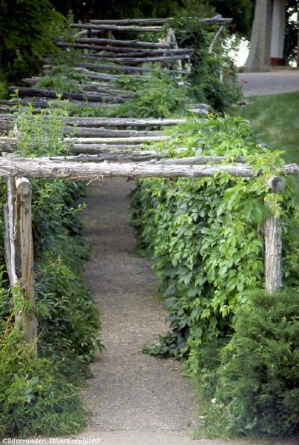
Identify potential venues and sites
Potential event locations
Convention halls
Exhibition centres
Reception wedding centres
Nature areas including open water, zoos, parks, wineries
Notes:
Class Activity – Discussion
What types of functions would be held in these locations?

Slide 42
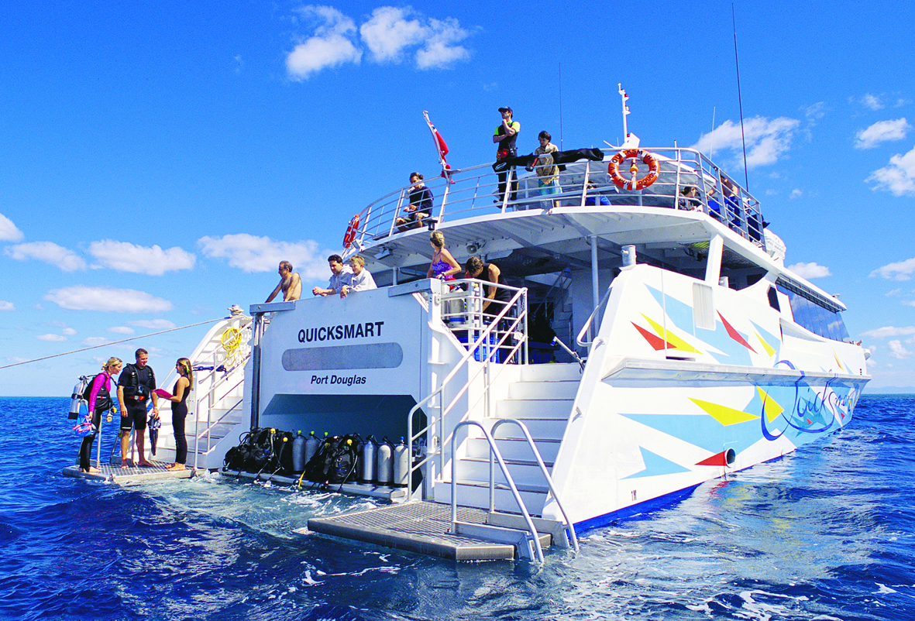
Identify potential venues and sites
Potential event locations
Transportation vehicles – including planes, yachts, cars, buses
Festivals
Sporting venues
Government buildings and civic centres
Museums
Notes:
Class Activity – Discussion
What types of functions would be held in these locations?

Slide 43
Analyse location options
Analysing steps include:
Collect information
Tour of the venue
Meeting key staff
Notes:
Class Activity – Discussion
What types of functions would be held in these locations?

Slide 44

Select event venue/site
Development of specifications against which to assess options
Compulsory requirements
Key requirements
Weighting scale
Comparison
Selection
Notes:
Class Activity – Discussion
What types of functions would be held in these locations?

Slide 45
Negotiate and agree upon final event details
Items to be negotiated include:
Price
Timing
Goods and services to be provided
Notes:
Class Activity – Discuss points.
What can be negotiated within these points?

Slide 46

Preparing the event contract
Once the event details have been verbally confirmed with the customer, standard practice requires:
A written agreement to be drawn up
To have it signed by all parties involved
Notes:
Class Activity – Questions
What information should be included in the Event Contract?

Slide 47
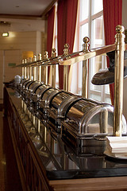
Preparing the event contract
Contents of a Contract
Full contact details of the client
Dates and times of the function
Date for notification of final numbers
Type of function
Service style
Seating arrangements
Equipment
Notes:
Class Activity – Discuss points in a contract
Discuss each point and important aspects to be recorded in each point.

Slide 48

Preparing the event contract
Contents of a Contract
Location of the function, name of rooms and facilities to be used
Approximate numbers attending
Décor, displays and table decorations
Food to be served – including when, type, amount
Beverages to be served
Entertainment, activities and inclusions
Notes:
Class Activity – Discuss points in a contract
Discuss each point and important aspects to be recorded in each point.

Slide 49
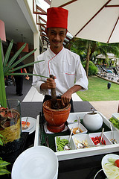
Preparing the event contract
Contents of a Contract
Services and facilities the venue has agreed to provide at no charge
Technology required
Access required by the client prior to the function
Products and services the client will be supplying
Involvement of third party suppliers
Total cost of function
Notes:
Class Activity – Discuss points in a contract
Discuss each point and important aspects to be recorded in each point.

Slide 50
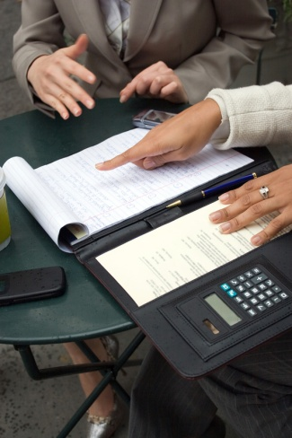
Preparing the event contract
Booking conditions
All venues will have specific booking conditions. These will usually appear on the website and form part of the standard function contract.
What information is normally included in booking conditions?
What are the benefits of having booking conditions?
Notes:
Class Activity – Questions
Ask questions in the slide.

Slide 51
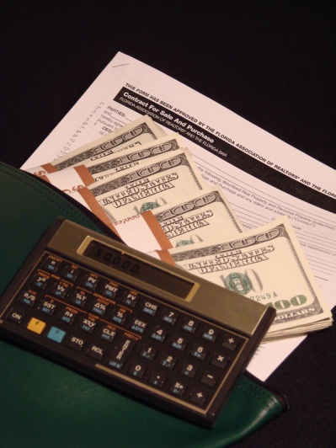
Obtaining deposit for function
It is standard industry practice to request a deposit when the final details of a function have been confirmed.
No function exists until a deposit has been paid
Notes:
Class Activity – Questions
What is the standard practice for requesting a deposit?
How much deposit is normally required?

Slide 52

Updated financial information
When the client pays a deposit for a function an account is usually opened for them at this stage.
Updating information can include:
Ensuring payment entries are recorded
Updating files when new payments are made
Notes:
Class Activity – Discuss the points in the slide

Slide 53

Preparing confirmations
A standard pro forma confirmation is sent to the client when they have signed the function contract and paid a deposit
This confirmation acknowledges the contract has been signed and that money has been paid and received
In addition a copy of Function Sheet is also sent
Notes:
Class Activity – Questions
What is the best way to send a confirmation and why?

Slide 54
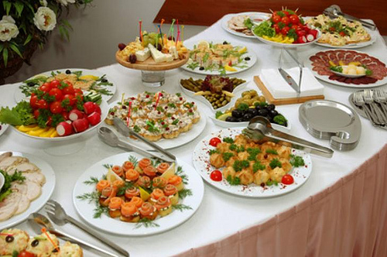
Element 3:
Plan and deliver event catering
Notes:
Introduce topic.
Class Activity – General Discussion
Ask general questions:
What different types of catering are used at events?

Slide 55
Plan and deliver event catering
Performance Criteria for this Element are:
Identify and analyse event factors which may impact on catering
Prepare event catering proposal
Prepare event catering operational plan
Implement event catering operational plan
Notes:
Trainer identifies the Performance Criteria for this Element, as listed on the slide.

Slide 56
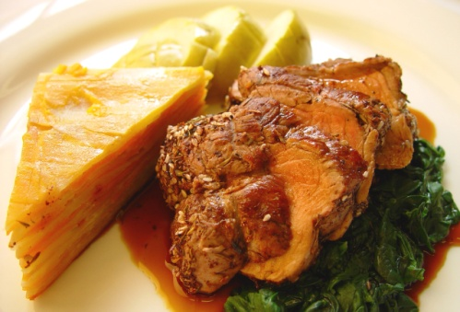
Factors impacting catering
Types of event factors that impact on catering
Available budget
Dates and time of function
Numbers of participants
Speed of service required due to timing demands on activities within an event
Types of food required
Service styles required
Cuisines preferred
Notes:
Class Activity – Questions
How will these factors impact on catering?

Slide 57
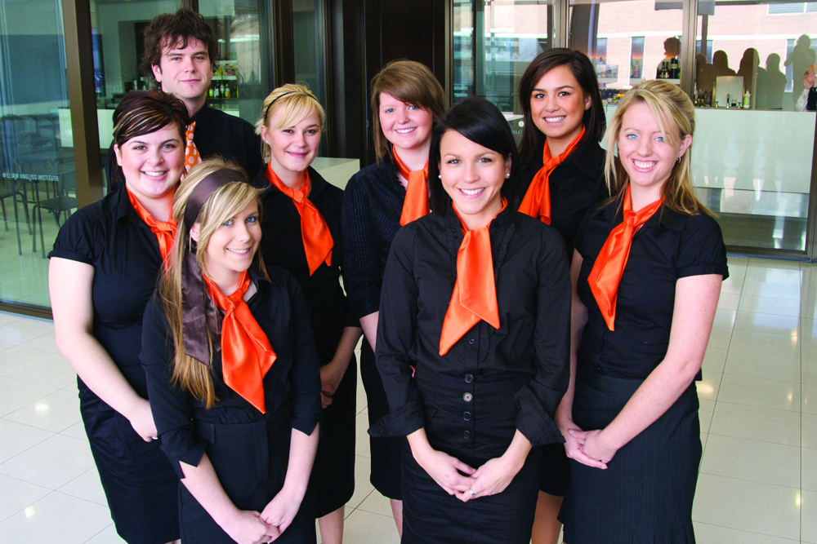
Factors impacting catering
Types of event factors that impact on catering
Location of event
Seasonal influences
Nature of event
Production and transport issues
General logistics
Staffing
Pre- and post-function activities
Notes:
Class Activity – Questions
How will these factors impact on catering?

Slide 58
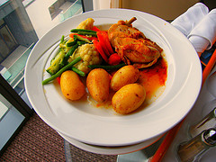
Event menu options
Menu considerations
Styles of functions
Styles of service required
Timing of functions
Providing a variety of price points
Having inclusive and non-inclusive menus
Notes:
Class Activity – General Questions
How can hotels provide a variety of price points?
What is the difference between inclusive and non-inclusive menus?

Slide 59

Types of food and beverage menus
Breakfast menu
Morning/afternoon teas
Lunch menu
Dinner menu
Seminar/conference
Wedding
Cocktail parties
Promotions and product launches
Notes:
Class Activity – General Discussion
Trainer to discuss the different menu items and how they would best be served?
Trainer may show examples of menus relating to these meal periods.

Slide 60

Types of food and beverage menus
The types and styles of food and beverage menus will vary greatly depending on:
Size and style of the venue
Type of function
Available budget
Client preferences
Nature of the function
Various timing factors
Notes:
Class Activity – General Discussion
Think about a range of different functions. What types of food and beverage would be appropriate?

Slide 61

Types of food and beverage menus
Client providing own items
It is not uncommon for the customer to bring some of their own items to suit the requirements of the occasion.
For birthdays and weddings it is normal for the customer to bring their own:
Cakes
Speciality wines
Decorations
Notes:
Class Activity – Questions
What items do hotels allow and not allow clients to bring?
What rules or charges apply when clients bring their own food and beverage items?

Slide 62
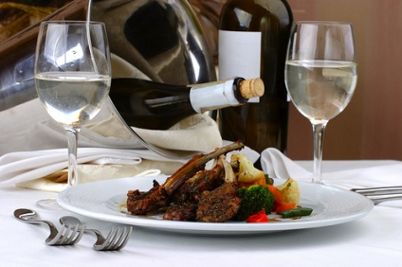
Styles of service
Different styles of service
Plated service
Silver service
Semi silver service
Gueridon service
Buffet service
Cocktail service
Notes:
Class Activity – General Questions
In what types of functions is are these different styles of service popular?

Slide 63

Types of food and beverage packages
There are many different types of menus options that are available to customers.
To keep it simple, functions present three common package options:
Inclusive
On consumption
On cash basis
Notes:
Class Activity – Questions
What is the difference between these types of packages?
What types of functions are commonly use each package?

Slide 64
Prepare and send proposal
Inclusions in a catering proposal
In summary an event catering proposal should include:
Details of all catering proposed – including menus, drinks, timing, service times
Costs
Options available within designated budget parameters
Overview of production, transportation and service of food and beverages
Staff numbers
Reference to previous events that have been catered for on the same/similar scale
Notes:
Class Activity – Questions
What needs to be included in a catering proposal?

Slide 65

Follow up proposal
Within 24 hours of sending out a proposal a follow up call is required. This is used to determine the following:
If they received the proposal
If you can be of further assistance
If you would like to confirm the booking
Explain Method Of Payment
Notes:
Class Activity – Questions
What is the best way to follow up?

Slide 66

Prepare catering operational plan
Contents of a catering operational plan
Final menus and beverages
Final arrangements regarding timing, locations and all agreed service issues
Final prices
Details of implementation protocols to ensure service and product delivery in accordance with the proposal
Notes:
Class Activity – Questions
What is the purpose of a catering operational plan?
What do different stakeholders use it for?

Slide 67

Prepare catering operational plan
Importance of Running Sheets
What is a Running Sheet?
What information is included in a Running Sheet?
What is it used for?
What are the benefits of using Running Sheets?
Notes:
Class Activity – Questions
Discuss the questions in this slide.

Slide 68

Rostering staff
One of the key requirements when planning for a function is to ensure that you are adequately staffed for the event
This is normally undertaken through the use of a roster
A roster is a plan that organises staff, indicating which staff are to work where and at what times
Notes:
Class Activity – Questions
Who is responsible for rostering?
What does rostering involve?
What is the purpose of a roster?

Slide 69
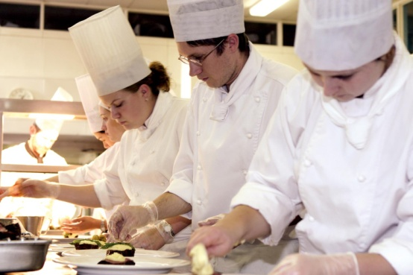
Rostering staff
Impacts on staffing
The amount and type of staff required to service a function will greatly depend on the:
Type of function
Service requirements
Numbers attending
Level of service required
Host of associated miscellaneous details
Notes:
Class Activity – Discussion
Explain how these points impact on rostering.

Slide 70
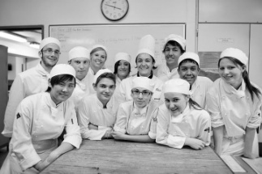
Rostering staff
Rostering considerations
Calculating staff numbers
Ensuring productivity standards are met
Meeting budget
Allocating the right mix of staff
Accessing staff
Confirming staff
Notes:
Class Activity – Discussion
Get the audience to think discuss the activities associated with each of these steps.

Slide 71

Element 4:
Plan and deliver sponsorship plans
Notes:
Introduce topic.
Class Activity – General Discussion
Ask general questions:
What is the use of sponsorship?
How do you get sponsorship?

Slide 72
Plan and deliver sponsorship plans
Performance Criteria for this Element are:
Identify sponsorship opportunities, where appropriate
Create and promote sponsorship packages, where appropriate
Implement sponsorship items and activities
Follow up with sponsors
Notes:
Trainer identifies the Performance Criteria for this Element, as listed on the slide.

Slide 73

Event sponsorship
Sponsorship is a common part of running an event
There are benefits for both the event organiser and the sponsoring business
Notes:
Class Activity – Questions
Why is event sponsorship common?
What are the benefits of sponsorship for both parties?
What types of sponsorship are there?
What do sponsors get for their investment?

Slide 74

Event sponsorship
Benefits for sponsors
Right to display and promote their name
Increase brand awareness
Affiliate with other organisations, charities or celebrities
Enhance the brand or visibility of an event by having a ‘reputable’ company behind it
Engage with the community and employees
Enhance product and service sampling
Improve contact and visual presence with the media
Notes:
Class Activity – Questions
What other benefits are there for sponsors?

Slide 75
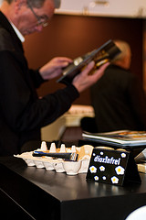
Event sponsorship
Identify potential sponsors
Potential sponsors can include:
Individuals
Government agencies
Companies
Industry organisations
Community groups
Notes:
Class Activity – Questions & Create list of sponsors for specific events
What other potential sponsors are there?
Think of a number of specific events and think of potential sponsors in which you could attract.

Slide 76

Event sponsorship
Identify potential sponsors
A great starting point is to compile a list of suitable sponsors. This can include:
Current vendors
Past sponsors
Business partners
Affiliated businesses
Notes:
Class Activity – Questions
What are the benefits and advantages of starting with these companies?

Slide 77
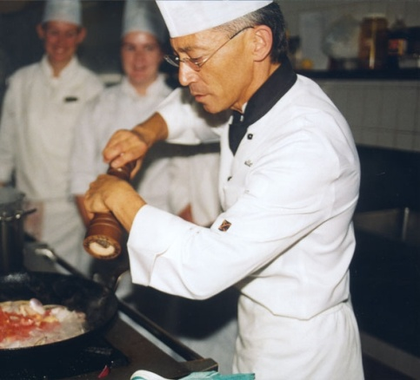
Event sponsorship
Types of sponsorship
There are a number of common types of sponsorship including:
Cash sponsorship
Product sponsorship
Venue sponsorship
Person sponsorship
Notes:
Class Activity – Questions
What are the advantages of these different types of sponsors?

Slide 78
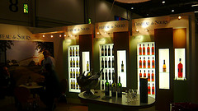
Sponsorship packages
Create different sponsorship levels
It is a proven idea to offer different sponsorship packages.
Each level will have a different financial cost and matching benefits.
What are examples of different levels of sponsorships for different events?
What is the cost?
What does the sponsor get?
Notes:
Class Activity – Questions and research
Trainer to get the audience to research different types of sponsorship packages for various events.

Slide 79
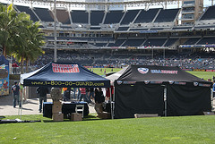
Sponsorship packages
Basic sponsorship categories / levels
Basic level sponsorship
Medium level sponsorship
Top level sponsorship
Notes:
Class Activity – Questions and research
Trainer to get the audience to think of inclusions for each category of sponsorship for two different types of events.

Slide 80
Sponsorship packages
Create different sponsorship levels
It is a proven idea to offer different sponsorship packages.
Each level will have a different financial cost and matching benefits.
What are examples of different levels of sponsorships for different events?
What is the cost?
What does the sponsor get?
Notes:
Class Activity – Questions and research
Trainer to get the audience to research different types of sponsorship packages for various events.

Slide 81
Sponsorship packages
Examples of sponsorship inclusions
Example – Food and Wine Festival
Signage/banner opportunities (stage, railing, towers, street pole, etc.)
Corporate logo on main stage
Category exclusivity
Promotional tent
Advertisement in program materials
Status level on event brochure
Notes:
Class Activity – Questions and research
Discuss these inclusions. Which ones would you find to be of value in you were a sponsor.

Slide 82
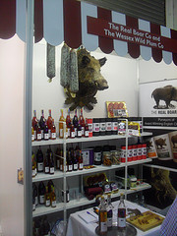
Sponsorship packages
Examples of sponsorship inclusions
Example – Food and Wine Festival
Corporate logo on event advertisements
Corporate logo at ticket windows
Mentions in radio advertising
Priority seating tickets
Use of corporate hospitality tents
Main stage presentations
Notes:
Class Activity – Questions and research
Discuss these inclusions. Which ones would you find to be of value in you were a sponsor.

Slide 83
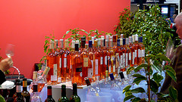
Sponsorship packages
Examples of sponsorship inclusions
Example – Food and Wine Festival
Main stage mentions
Opportunity to bring inflatable for increased visibility
Corporate press releases with event press kits
Parking and delivery permits
Opportunity to distribute pre-approved sample items
Notes:
Class Activity – Questions and research
Discuss these inclusions. Which ones would you find to be of value in you were a sponsor.

Slide 84

Sponsorship items and activities
Summary of items and activities to prepare
Sponsorship items and activities that need to be prepared may include:
Overall event sponsorship and/or segmented sponsorship
Satchels, gifts and physical items
Meals, drinks, travel, accommodation, speakers, social events
One-off promotional activities and on-going organisational activities
Notes:
Class Activity – Questions & Review example for a large sporting event in the Trainee Manual
What are different types of items and activities that need to be prepared for different types of events?

Slide 85

Follow up with sponsors
Importance of communicating with sponsors
Why is it important to communicate with sponsors?
How would this be done?
How often would it be done?
What involvement would sponsors need to have during the planning and implementation of an event?
Notes:
Class Activity – Questions
Discuss the questions in the slide.

Slide 86
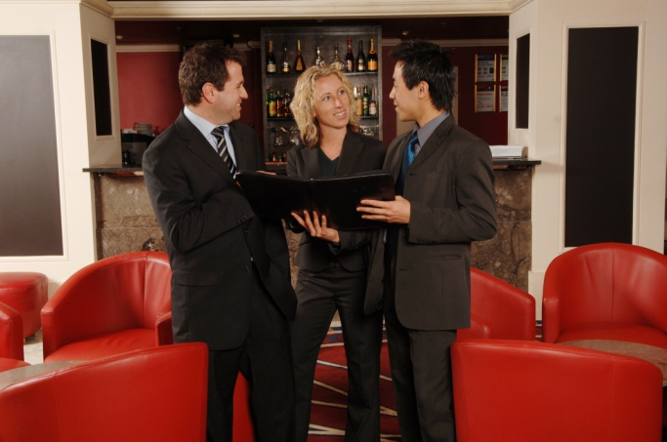
Element 5:
Plan and deliver event management
Notes:
Introduce topic.
Class Activity – General Discussion
Ask general questions:
What is the use of sponsorship?
How do you get sponsorship?

Slide 87
Plan and deliver event management
Performance Criteria for this Element are:
Liaise with event stakeholders
Prepare event management plan
Manage event set up in-line with event management plan
Monitor conduct and implementation of event in-line with event management plan
Manage finalisation of event and event breakdown in-line with event management plan
Notes:
Trainer identifies the Performance Criteria for this Element, as listed on the slide.

Slide 88

Liaise with stakeholders
All successful functions are a result of effective teamwork.
There is a need to involve others in the planning phase:
Who would you involve?
What help can they offer?
Notes:
Class Activity – Discussion & Questions
Ask questions in the slide.

Slide 89
Liaise with stakeholders
Who might be involved?
Executive Chef
Beverage Manager
Maintenance Department
Executive Housekeeper
Catering and Conference Coordinator
Purchasing Manager
Front Office Manager
Security
Notes:
Class Activity – Questions
What specialist advice can these people provide?
How is it best to involve them?
Food requirements discussed with Executive Chef
Beverage requirements discussed with Beverage Manager
Technical requirements discussed with Maintenance Department or outside suppliers
Linen requirements discussed with housekeeping – outside suppliers may also be involved
Room decorations and floral arrangements discussed with housekeeping or outside suppliers
Facility set-up requirements discussed with Catering and Food and Beverage or functions coordinator.

Slide 90

Prepare event management plan
Once all details of an event have been finalised and confirmed it is vital that event management prepare a detailed event management plan
This plan takes into consideration all possible scenarios and activities that need to either be planned or addressed
Notes:
Class Activity – Discussion
What should be included in an event management plan?

Slide 91

Prepare event management plan
Inclusions in an event management plan
Staffing requirements
Security
Management of external contractors
Running sheets
Briefing papers
Staging elements or requirements
Notes:
Class Activity – Discussion
Discuss these inclusions?
What needs to be considered or actioned in relation to each point?

Slide 92

Prepare event management plan
Inclusions in an event management plan
Catering arrangements
Liaison with stakeholders, dignitaries, delegates and guests, media, sponsors
Guest/delegate management on arrival, during the event and on departure
Risk management
Emergency management
Performance standards and guidelines
Notes:
Class Activity – Discussion
Discuss these inclusions?
What needs to be considered or actioned in relation to each point?

Slide 93
Prepare event management plan
Inclusions in an event management plan
Traffic management
Specification of control, command and communication structures
Scopes of responsibility, identification of key contact details for event managers
Use of technology
Timing and co-ordination of services, facilities
Contingency plans
Notes:
Class Activity – Discussion
Discuss these inclusions?
What needs to be considered or actioned in relation to each point?

Slide 94

Arrange external services
Many individual functions traditionally may require the use of specialised skills or equipment which may not be available within the organisation
At these times, external services will be utilised
Notes:
Class Activity – Questions
What types of external businesses are utilised in functions?

Slide 95

Arrange external services
Types of external providers
Florists
Photographers
Party Hire companies
Entertainers
AV Technicians
Printers
Notes:
Class Activity – Questions
What specialist products or services do these businesses provide?

Slide 96
Arrange external services
Sourcing option
Like with any business, different companies will offer different products and services as a means of identifying their point of difference
It is a good idea to source at least three companies
Notes:
Class Activity – Questions
Where can you find information on different types of external suppliers?

Slide 97

Arrange external services
Liaising with providers to understand offering
Range of offering
Pricing structure for each item
Service guarantees
Availability
Prep-event services
Event services
Post-event services
Billing and payment arrangements
Notes:
Class Activity – Questions
What information would you like to know about external suppliers?
Range of offering – selection of products and services
Pricing structure for each item – including discounts or complimentary additional items
Service guarantees – what quality and quantity guarantees can they provide
Availability - how available are items. It is no use choosing a provider, no matter how cheap, if their items are never available
Prep-event services – delivery and setting up arrangements
Event services- what will the company do during the event to ensure its products or services operate as expected
Post-event services – take down and removal of items, cleaning etc
Billing and payment arrangements.

Slide 98
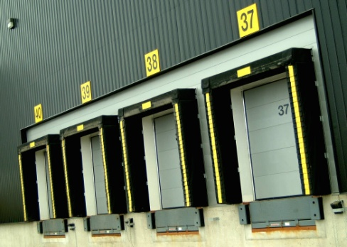
Arrange external services
Facilitating access by external providers
It is essential that providers understand:
What time they have access
Delivery and parking zones
Storage areas
Commencement and finishing times of the function
Amount of time allocated after the event for access
Notes:
Class Activity – Questions
Why is it important to discuss these points with external providers?
Trainer to provide examples of information that may be given to external suppliers in relation to each of these points.

Slide 99
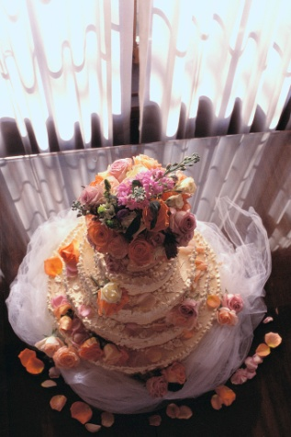
Arrange external services
Connecting service providers with customer, where appropriate
In many cases functions staff will suggest that external providers correspond directly with the client because:
Functions staff do not have the technical knowledge or understanding
External providers can explain what they can offer and provide suggestions
Can remove a level of activity or responsibility from the functions department
Notes:
Class Activity – Discussion
Discuss points.

Slide 100

Preparing function sheets
A function sheet, sometimes also known as an ‘event order’ or ‘function order’, is an internal communication form developed to suit each venue’s needs that sets out the details of a function:
What information is included in a Function Sheet?
Notes:
Class Activity – Questions
Ask the question in the slide.

Slide 101

Preparing function sheets
Contents of a function sheet
Type of function
Name, address, and contact number of client
Day, date and time of the function
Rooms and locations
Billing instructions
Menu
Notes:
Class Activity – Discussion & Questions
Discuss points in the slide
What information would you like to know under each point?
Type of function – wedding, launch of product, ball
Name, address, and contact number of client
Day, date and time of the function
Rooms and locations where the function will be held
Billing instructions – who gets the bill, their address
Menu – break-down course-by-course of the agreed dishes including specification of ‘on arrival’ food, morning and afternoon teas.

Slide 102
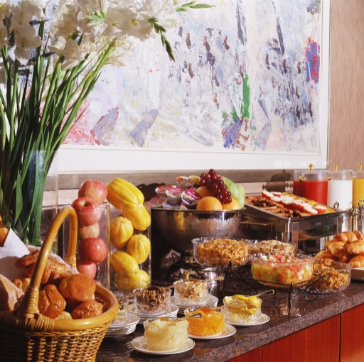
Preparing function sheets
Contents of a function sheet
Beverage arrangements
Sequence of service
Entertainment
Room set up
Type of service
Special requirements
Notes:
Class Activity – Discussion & Questions
Discuss points in the slide
What information would you like to know under each point?
Beverage arrangements – description and quantities of beverages to be provided
Sequence of service – covering timing of service, and details of when speeches and presentations will occur
Entertainment – details of bands and the order of ceremony.
Room set up – number of tables, floor plan, decorations, table set-ups including cutlery, crockery and table accoutrements
Type of service – plated, tray, buffet, silver service, finger food
Special requirements – commonly relating to technology requirements such as microphone, DVD facilities, data projector, sound and lighting.

Slide 103

Minimise impact of function
Functions affecting other outlets
Most function departments within a hotel are very busy places, with a number of events being held at the same time.
It is important that each function does not greatly impact on:
Other functions
General hotel outlets
Notes:
Class Activity – Questions
What are common impacts that affect other functions or hotel outlets?
What can you do to minimise this impact?

Slide 104
Minimise impact of function
Impacts
Shortage of staff
Loss of power or IT connections
Equipment malfunctions
Excess noise affecting other areas of the business
Shortage of food and beverage products and any associated items
Notes:
Class Activity – Questions
What are the causes of these impacts?
What can you do to minimise this impact?

Slide 105
Minimise impact of function
Impacts
Unacceptable behaviour
Disruption to normal service caused by closure of room/areas
Restricted access to the venue
Reduced availability of parking for regular customers
Notes:
Class Activity – Questions
What are the causes of these impacts?
What can you do to minimise this impact?

Slide 106
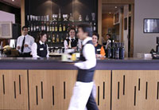
Monitor set up of function
It is critical to have the function set up and ready to go by the agreed starting time
A key objective when monitoring set up for a function is that all necessary mise-en-place is completed
Notes:
Class Activity – Questions
What does the term mise-en-place mean?

Slide 107
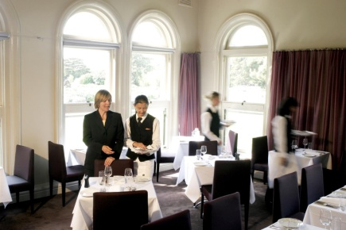
Mise-en-place
Mise-en-place is a French term that means ‘to put in place’.
Therefore, ‘set up and mise-en-place’ refers to all the activities required to prepare the room for service:
What mise-en-place activities need to be undertaken when preparing a function?
Notes:
Class Activity – List mise-en-place activities
Trainer to break audience into groups
Give each group one job role
Get them to identify all mise-en-place activities that would need to be completed before a function.

Slide 108
Using checklists
Importance of Checklists
An industry-wide method of monitoring completion and performance of activities is to use a series of checklists
Notes:
Class Activity – Questions
What is the purpose of a checklist?
What information should be included in a checklist?

Slide 109

Planning set up
Many venues will have plans of previous function set-ups to guide set-ups.
In all instances the room set-up must be in accordance with client wishes as set out in the contract.
What needs to be planned?
Notes:
Class Activity – Questions
What needs to be planned?
What influences planning?

Slide 110
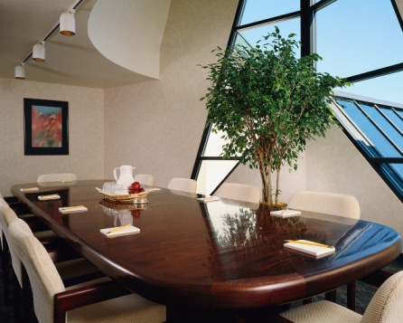
Planning set up
Setting up tables
When setting up the relevant locations the function sheet should be referred to determine the need for specific furniture such as:
Display tables
Registration tables
Tables for merchandise and delegate materials, catering and IT requirements
Notes:
Class Activity – Questions
What are other considerations when setting up tables for different events?

Slide 111
Mise-en-place
Floor-related mise-en-place tasks
Preparing, polishing and setting glasses on each table at each setting
Preparing crockery and cutlery
Checking support items are ready
Folding napkins
Preparing condiments
Notes:
Class Activity – Discuss and demonstrate mise-en-place activities
Preparing, polishing and setting glasses on each table at each setting – including the equipment to ensure that glassware is available and has been prepared to support the service of special beverages as required for the function
Preparing crockery and cutlery – for placement on tables. Most premises require crockery to be checked to ensure it is clean and free of chips or cracks and that cutlery is to be polished prior to being set
Checking that items required to support the service of menu items as listed are ready and available. This can include:
Platters, lids and covers
Service utensils – such as spoons and forks for silver service, tongs, cake lifts and stands, sauce boats and underliners
Oven-to-table ware – this is commonly the responsibility of kitchen staff but waiting staff may be responsible for ensuring the stands or mats that these hot items are placed on are ready and available
Folding napkins – including the preparation of waiter’s cloths/napkins ready for use on clothed service plates
Preparing condiments – including re-filling, cleaning and placement on tables and in waiter’s stations.

Slide 112
Mise-en-place
Floor-related mise-en-place tasks
Preparing butters
Readying all equipment
Checking or preparing display materials
Preparing and checking operational readiness of cash registers
Notes:
Class Activity – Discuss and demonstrate mise-en-place activities
Preparing butters – including spares to cater for situations where extra butter is required
Readying all equipment – such as espresso machines, tea and coffee-making equipment, bain maries, waiter’s stations
Checking or preparing display materials – some properties will feature a display table to fit in with a theme
Preparing and checking operational readiness of cash registers where a cash service is operating – this can include collecting and counting the float, obtaining change, checking the audit tape is sufficient for the up-coming session, and ensuring date/time is correct. This may be the role of bar staff in some venues where accounts are processed through the bar register.

Slide 113
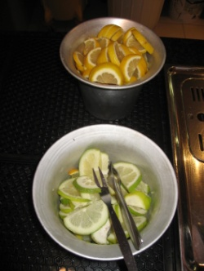
Mise-en-place
Bar related mise-en-place tasks
Storing beverages that have been delivered to the bar
Preparing bar garnishes
Preparing ice
Preparing and checking operational readiness of cash registers
Checking to see that all beverages listed on running sheets are available
Notes:
Class Activity – Discuss and demonstrate mise-en-place activities
Storing beverages that have been delivered to the bar – where stock is waiting to be put away. This is usually the first job to do in order to get drinks that require refrigeration into the fridges as soon as possible. All stock should be rotated using the First In, First Out method meaning that existing stock should be moved forward and the new stock stored behind it
Preparing bar garnishes – these should include the basic lemon and orange slices and lime quarters as well as more sophisticated garnishes for any cocktails that are being offered as part of the function.
Preparing ice – including obtaining ice, crushing ice and readying ice buckets and stands
Preparing and checking operational readiness of cash registers – if a cash bar system is operating
Checking to see that all beverages listed on running sheets are available – and noting those that are not for mention at the staff briefing or ordering replacement stock as require.

Slide 114

Mise-en-place
Bar related mise-en-place tasks
Checking the post-mix
Turning on espresso coffee machine
Setting out drip trays
Setting out under-trays and racks for dirty glassware
Checking equipment and bar utensils are clean and in working order
Notes:
Class Activity – Discuss and demonstrate mise-en-place activities
Checking the post-mix – to make sure it is fully operational for all flavours and the water button, and is being delivered at the right temperature and strength
Turning on espresso coffee machine
Setting out drip trays – with de-naturing agent
Setting out under-trays and racks for dirty glassware
Checking equipment and bar utensils are clean and in working order – this check should include all operational bar equipment.

Slide 115
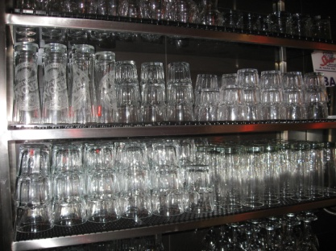
Mise-en-place
Bar related mise-en-place tasks
Checking glassware to ensure no cracks, chips, lipstick marks, etc
Placing spirit pourers on the appropriate bottles
Stacking and ensuring cleanliness of service trays
Filling up ice buckets
Opening pre-selected wines
Notes:
Class Activity – Discuss and demonstrate mise-en-place activities
Checking glassware to ensure no cracks, chips, lipstick marks, etc
Placing spirit pourers on the appropriate bottles – ensuring sufficient supply of liquor
Stacking and ensuring cleanliness of service trays
Filling up ice buckets
Opening pre-selected wines.

Slide 116
Mise-en-place
Bar related mise-en-place tasks
Preparing and filling water jugs or other items
Prepare pre-ordered drinks
Set out appropriate glassware on the tables
Prepare service trays and drinks
Notes:
Class Activity – Discuss and demonstrate mise-en-place activities
Preparing and filling water jugs or other items that are to be pre-placed on function tables
Prepare pre-ordered drinks
Bar staff may also be required to set out appropriate glassware on the tables and to prepare service trays and drinks for, say, pre-function drinks in the lobby or champagne.

Slide 117
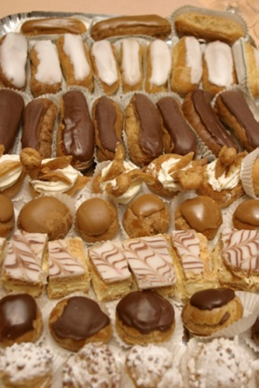
Purchase necessary stock
Stock is a very important aspect of a function and without it no function can take place.
Many functions require a wide variety of stock items which need to be arranged, whether:
Borrowed from other departments
Ordered internally through the purchasing department
Purchased or hired through external providers
Notes:
Class Activity – Research activity
Trainer to break the audience into small groups
Give each group a specific type of function
Get them to identify the types of stock are commonly for that function
Get them to identify how these items can be arranged, taking into consideration the options provided in the slide.

Slide 118
Purchase necessary stock
Types of stock
Food and beverages
Decorations
Stationery
Equipment
Linen
Notes:
Class Activity – Discussion
Discuss the different types of stock.
Food and beverages to match identified menu selections
Decorations – including flowers, table decorations and displays, stage decorations, dance floors, bunting and other decorations as requested by customer
Stationery– such as meeting note pads, pens, folders, pencils, whiteboard markers, butcher’s paper, name card holder, name tags etc
Equipment – data projectors, whiteboards, DVD players, AV equipment etc. These items are normally hired as opposed to purchased
Linen – table covers, chair covers, napkins, skirting etc.

Slide 119
Purchase necessary stock
Types of stock
Crockery and glassware
Cleaning supplies
Consumables
Notes:
Class Activity – Discussion
Discuss the different types of stock.
Crockery and glassware
Cleaning supplies – such as cleaning chemicals (all-purpose cleaners, abrasive cleaners, deodorisers, window cleaners, carpet spot cleaner) and cleaning equipment (cleaning gloves, mops and buckets and machines such as vacuum cleaners, polishers etc.)
Consumables - such as toilet paper, rubbish bin liners, soap for use in public toilets, light globes, tissues, paper towels and so on.

Slide 120

Conduct pre-function briefings
The best way to communicate to staff the requirements of an event is in the form of a pre-function briefing when staff are all together.
What needs to be discussed?
Who should attend?
Notes:
Class Activity – Questions
Ask questions in the slide.

Slide 121

Monitor service delivery
Not only is it important that activities are monitored in the lead up to a function, it is absolutely essential that they are monitored as the function is taking place
Managers must ensure that work activities designated to staff or make up their job role, must be completed in an acceptable manner within the desired timeframes
Notes:
Class Activity – Questions
Why is it important to monitor service delivery?
How can you do it?

Slide 122

Monitor service delivery
Common monitoring methods
Workplace observation
Talking to staff
Feedback from the function co-ordinator or customers of the function
Notes:
Class Activity – Questions
Which is the most effective method?
What information can be obtained from each method?
Workplace observation – watching what goes on as it happens, reading customer body language and measuring waiting times
Talking to staff – to get their impressions, to identify obstacles that will impact on the ability to perform function activities
Feedback from the function co-ordinator or customers of the function - constant liaison with the client or their delegated representative is a given in large functions where there are multiple sites and multiple activities.

Slide 123

Monitoring the function
Areas to monitor
Checking running times
Adjusting service delivery to align with Running Sheet
Arranging changes to the agreed Running Sheet to accommodate the need to do so
Ensuring quality service delivery
Ensuring all customer requirements are met
Notes:
Class Activity – Questions
For each of these points:
Why is it important to monitor it?
How can you monitor it?

Slide 124
Monitoring the function
Areas to monitor
Responding to queries and requests from clients and guests
Liaising with customer during function to check level of satisfaction
Enquiring if customer has additional requirements during service
Providing additional items as required
Clearing rubbish and used items
Notes:
Class Activity – Questions
For each of these points:
Why is it important to monitor it?
How can you monitor it?

Slide 125

Taking action to address service problems
It is a fact of life there will be problems of some sort at any function
Even where appropriate planning and preparation has taken place it is still likely there will be problems
Problems may be caused by equipment failure, shortage of materials, patrons
Many problems relate to timing issues
Notes:
Class Activity – Questions
What are common problems that occur?
What are the causes?
How can you reduce their occurrence?
How can you reduce its impact on customers?

Slide 126
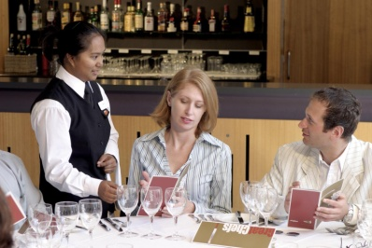
Taking action to address service problems
Actively monitor all aspects of the function
Communicate with relevant people about what is happening
Take immediate action
As soon as you notice a problem or a timing issue you have to immediately begin to do something to resolve or address the situation.
Notes:
Class Activity – Share stories about problems and how they were or could have been resolved
Trainer to get audience to share stories, where they were staff or customers at a function where problems took place.

Slide 127
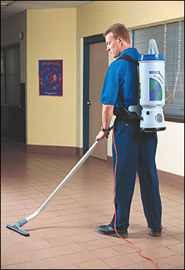
Monitor event breakdown
Identifying time of next event of function
Why is this important?
Monitor event breakdown activities?
What activities take place during the breakdown of an event?
How do you monitor these activities?
Notes:
Class Activity – Discussion
Discuss the questions in the slide.

Slide 128
Element 6:
Plan and deliver event registration
Notes:
Introduce topic.
Class Activity – General Discussion
Ask general questions:
What is the role of registration?
What activities are associated with registration?

Slide 129
Plan and deliver event registration
Performance Criteria for this Element are:
Take event bookings and process event registrations
Monitor on-going event registrations and take remedial action where necessary to increase attendance/registrations
Finalise event registrations
Produce identified event materials for guests and delegates
Coordinate and process guest and delegate registration at the event
Notes:
Trainer identifies the Performance Criteria for this Element, as listed on the slide.

Slide 130
Event registration
Role of event registrations and bookings?
What are the benefits of these?
Why are these necessary?
How are they taken?
What information do they record?
Notes:
Class Activity – Discussion
Discuss the questions in the slide.

Slide 131

Event registration
Types of registrations or bookings
Travel to and from the venue
Accommodation
Car hire
Meals
Sessions/ workshops
Pre-dinner cocktails
Dinner with keynote speaker
Post-meeting entertainment
Recreational activities
Notes:
Class Activity – Discussion
How are they taken?
What other types of reservations or bookings are taken for an event?

Slide 132
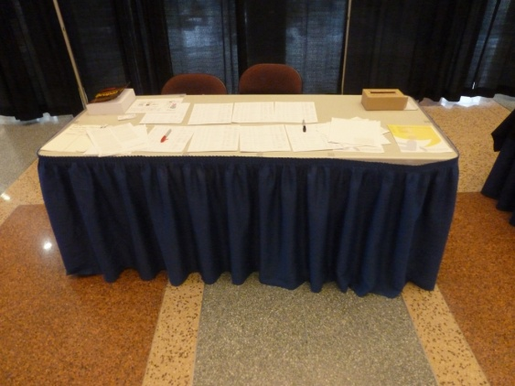
Event registration
The Registration Process
Every meeting or event has a basic registration procedure.
Expression of Interest
Registration Brochure
Registration Form
Process Registrations
Registration at the event
Notes:
Class Activity – Discussion
What steps are associated with each of these tasks?

Slide 133

Event registration
Expression of interest
An ‘Expression of Interest’ form is used to gather information of whether people would be interested in attending your event as a delegate, speaker or exhibitor.
Who is this form send to?
How is it sent?
What information would you include in the form?
Notes:
Class Activity – Discussion
Discuss the questions in the slide.

Slide 134
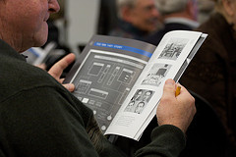
Event registration
Registration Brochure
The brochure is designed to give information
The purpose of a registration brochure is to not only inform potential audiences of an upcoming event but appeal to their needs, either as a delegate, speaker or exhibitor
Notes:
Class Activity – Discussion
What information is needed by delegates?

Slide 135
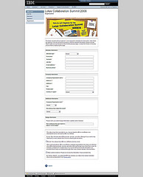
Event registration
Registration Form
The form is designed to collect information
The registration form or database is designed to capture all the important information relevant to guest or delegate registration for an event
Notes:
Class Activity – Discussion
What information is needed by event organisers?

Slide 136

Event registration
Inclusions in a Registration Form
Event Details
Delegate details
Types of registrations
Travel information
Accommodation
Notes:
Class Activity – Discussion
What information is needed by event organisers for each of these categories?

Slide 137
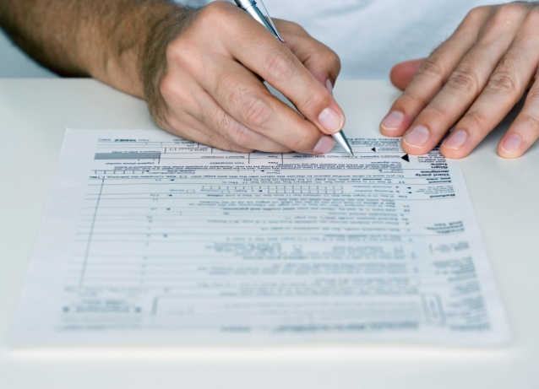
Event registration
Inclusions in a Registration Form
Car Hire
Special requirements
Payment details
Insurance
Notes:
Class Activity – Discussion
What information is needed by event organisers for each of these categories?

Slide 138

Event registration
Process registrations
This includes the following activities:
Enter information into database
Send out confirmation letters, itineraries, receipts
Make bookings with suppliers for rooms, flights, meals etc
Identifying dietary requirements and special requests
Notes:
Class Activity – Discussion
What information is needed by event organisers for each of these categories?

Slide 139

Event registration
Monitor event registration
Why is it important to monitor event registrations?
How can you do this?
Why is it important to maintain accurate records?
What information needs to be updated on a regular basis?
Notes:
Class Activity – Discussion
Discuss the questions in the slide.

Slide 140

Finalise event registration
Types of registrations correspondence
Inward Registration Correspondence
Letters of Confirmation
Identify Special requirements
Press Releases
Refund Advice
Conference Agenda
Merchandise and Sales Items
Notes:
Class Activity – Discussion
What is the purpose of each piece of registration correspondence?
What is included in these?

Slide 141
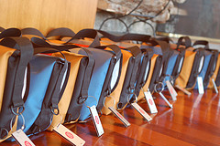
Produce event materials
Types of event materials
Conference Kit
Satchels
Promotional Items
Merchandise and sales items
Name Badges
Card and carriers
Service vouchers
Notes:
Class Activity – Discussion
What is included in these event materials?
Who prepares these?

Slide 142

Coordinate registration desk
Registration desk
The registration Desk area is a focal point for everyone involved including:
Venue
Committee
Presenters / Guest Speakers
Sponsors
Exhibitors
Delegates
Accompanying Persons
VIP’s / Guests
Notes:
Class Activity – Discussion
What is the purpose of the registration desk?

Slide 143

Coordinate registration desk
Registration desk considerations
What are considerations when preparing a registration desk?
What do you need to confirm with venue management?
Notes:
Class Activity – Discussion
Discuss the questions in the slide
Refer to the Trainee Manual for a complete list of questions that need to be considered.

Slide 144

Coordinate registration desk
Preparing for registrations
Name tags prepared in numerical or alphabetical order
Clear registrations signage / other signage
Adequate Staff to look after attendees
List of registrations for all staff
Satchels / handouts / agenda
Queuing issues
Late registrations desk
Notes:
Class Activity – Discussion
Discuss these inclusions.

Slide 145

Coordinate registration desk
Preparing for registrations
Security of money obtained through late registration
Undercover for registration facilities
Relief staff for registration
Food and beverage for staff
Telephone
Computer / Laptop
Uniform
Notes:
Class Activity – Discussion
Discuss these inclusions.

Slide 146
Coordinate registration desk
The registration process
Give each person a friendly welcome
Ask for their names and/or copy of their confirmation letter or invitation
Find their envelope with name badge and function tickets and confirm these are correct as you hand them to delegates
Explain briefly what information is in the satchel
Notes:
Class Activity – Discussion
Discuss the reservation process that is conducted at the registration desk.

Slide 147

Coordinate registration desk
The registration process
Advise when and where the first session is to take place or how the exhibition works
Advise of any changes to the program or additional information they may need to know
Wish them an enjoyable time and advise that you will be there to answer any questions
Notes:
Class Activity – Discussion
Discuss the reservation process that is conducted at the registration desk.

Slide 148
Coordinate registration desk
Variations to a Normal Registration
A delegate has registered but not paid
A delegate has not registered but turns up on the day
A delegate has registered but you do not have any information or details for him/her
A delegate now advises he/she cannot go to a function or now wishes to attend a function previously declined
Notes:
Class Activity – Discussion
How do you handle these situations?

Slide 149
Element 7:
Plan and deliver infrastructure for outdoor event
Notes:
Introduce topic.
Class Activity – General Discussion
Ask general questions:
What is infrastructure?
What are common outdoor events?
What types of infrastructure are used in outdoor events?

Slide 150
Plan and deliver infrastructure for outdoor event
Performance Criteria for this Element are:
Identify necessary infrastructure requirements
Organise identified infrastructure needs
Monitor implementation of identified infrastructure requirements
Notes:
Trainer identifies the Performance Criteria for this Element, as listed on the slide.

Slide 151

Outdoor event considerations
Importance of outdoor events
Why are outdoor events popular?
What types of outdoor events are there?
Where are they normally held?
What infrastructure needs to be organised for these events?
Notes:
Class Activity – Discussion
Discuss the questions in the slide.

Slide 152

Outdoor event considerations
Outdoor event considerations
Food, beverage or alcohol
Tables, chairs, stage, grounds keeping, toilets etc
Tent, sheltered or enclosed spaces
Sound and lighting systems
Merchandise sales
Types of customers
Security
Notes:
Class Activity – Discussion
How will these affect infrastructure needs?

Slide 153

Outdoor event considerations
Outdoor event considerations
Transportation, traffic and parking
Entertainment
Ticket sales
Weather back up plans
Permits or special licenses
Local council restrictions
Notes:
Class Activity – Discussion
How will these affect infrastructure needs?

Slide 154

Outdoor event considerations
Types of infrastructure requirements
Power and water supply
Food and beverage equipment
Tables, chairs and related items
Environmental control
Toilets
Emergency services
Notes:
Class Activity – Discussion
Discuss these infrastructure needs.

Slide 155

Outdoor event considerations
Types of infrastructure requirements
Car and coach parking
Disabled access
Signage
Waste management
Animals and insects
Weather considerations
Entertainment infrastructure
Notes:
Class Activity – Discussion
Discuss these infrastructure needs.

Slide 156

Outdoor event considerations
Organise infrastructure needs
Prepare a plan
Identify suppliers
Arrange delivery dates and times
Provide access and security details
Notes:
Class Activity – Discussion
Discuss the organisational activities associated when handling these infrastructure needs.

Slide 157

Outdoor event considerations
Monitor implementation of identified infrastructure requirements
Why is it important to monitor the set up of infrastructure?
How do you do this?
What are you looking for?
Notes:
Class Activity – Discussion
Discuss the questions in the slide.

Slide 158

Element 8:
Conduct post-event evaluation
Notes:
Introduce topic.
Class Activity – General Discussion
Ask general questions:
What activities need to take place after an event?
What interaction takes place between the event co-ordinator and the client?
What needs to be evaluated?
How does this evaluation take place?

Slide 159
Conduct post-event evaluation
Performance Criteria for this Element are:
Meet with client to discuss the event and finalise outstanding issues
Meet with sponsors to analyse their thoughts
Meet with staff to debrief the event
Calculate the financial outcome of the event
Determine the extent to which the event attained the identified objectives that were set for it
Notes:
Trainer identifies the Performance Criteria for this Element, as listed on the slide.

Slide 160

Obtain feedback from customers
It should be standard practice during and after every function to seek feedback that may be used to assist in the planning and implementation of future functions.
When is the best time to get feedback?
How can you get feedback?
What do you want to know?
Notes:
Class Activity – Questions
Ask questions in the slide.

Slide 161
External provider feedback
Matters which could be addressed include:
Did they have sufficient information to enable them to provide the goods and services?
What extra information do they need next time?
What issues very evident
What suggestions do they have that may assist in the planning and execution of future functions
Notes:
Class Activity – Questions
What is the best way to get feedback from external providers?
What do you want to know from them?

Slide 162

Sponsor feedback
Meet with sponsors to analyse their thoughts
Why is this important?
How is this done?
What information do you want from them?
What information do they want?
Notes:
Class Activity – Questions
Discuss the questions in the slide.

Slide 163

De-brief staff
In the same way that some properties encourage or require supervisors to hold a briefing session with staff at the start of a session, they also encourage a de-briefing session to be held at the completion of the session.
What should be asked in a de-brief?
When should it be done?
Who should attend?
Notes:
Class Activity – Questions
Discuss the questions in the slide.

Slide 164

Obtain payment for function
Once the function has been concluded and all the feedback has been collected by the customer, it is now time for the client to settle the account.
What steps are involved in preparing the account?
How can a client settle an account?
What happens if the client doesn’t agree with the price?
What if they don’t pay?
Notes:
Class Activity – Questions
Ask questions in the slide.

Slide 165

Preparing the account
Possible charges
Charges may include:
Food and beverage
Entertainment
Venue hire
Labour
Notes:
Class Activity – Discussion
Discuss these charges.
Food and beverage – as per initial agreement, taking into account adjustments ‘on the day’
Entertainment – bands, artists, personalities
Venue hire – fees for rooms
Labour – technical and service staff to set up rooms, activities or operate equipment during the function.

Slide 166

Preparing the account
Possible charges
Flowers
Audio-visual equipment hire
Printing, photocopying, secretarial services, phone and fax usage
Ice or margarine carvings, balloons, streamers and other specialised decorations
Dance floor hire
Notes:
Class Activity – Discussion
Discuss these charges.

Slide 167

Preparing the account
Next steps:
Verifying the account with management
Presenting the account
Process using correct method of payment
Notes:
Class Activity – Discussion
Discuss these steps.

Slide 168

Complete administration documentation
It is quite common for the Functions manager to complete a range of documentation at the completion of a function
There is generally an urgency associated with this as the venue will commonly seek to finalise this aspect of the function as soon as possible
Notes:
Class Activity – Questions
What documentation needs to be prepared and finalised?

Slide 169

Determine event objective attainment
Determine the extent to which the event attained the identified objectives that were set for it
What different event objectives may an event organiser have?
How can these be measured?
Notes:
Class Activity – Discussion
Discuss the questions in the slide.
Trainer thanks students for their time and attention.

